Slide 1
STUDENT NAME:ANGELA WANJIKU NJERI INSTITUTION AFFILIATION :SEVENNET BOOT CAMP CLASS UNIT:MICROSOFT EXCEL INSTRUCTOR:RAGHUVENDRA ANSHU DATE:13/07/2024
FINAL EXCEL PROJECT – BASED ON MOVIE DATASET

Slide 2
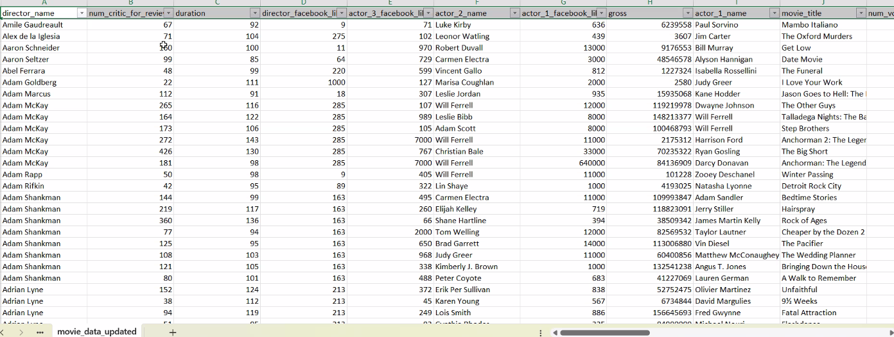
Data cleaning process step 1:Filtering -by adding filter on the row heads.

Slide 3
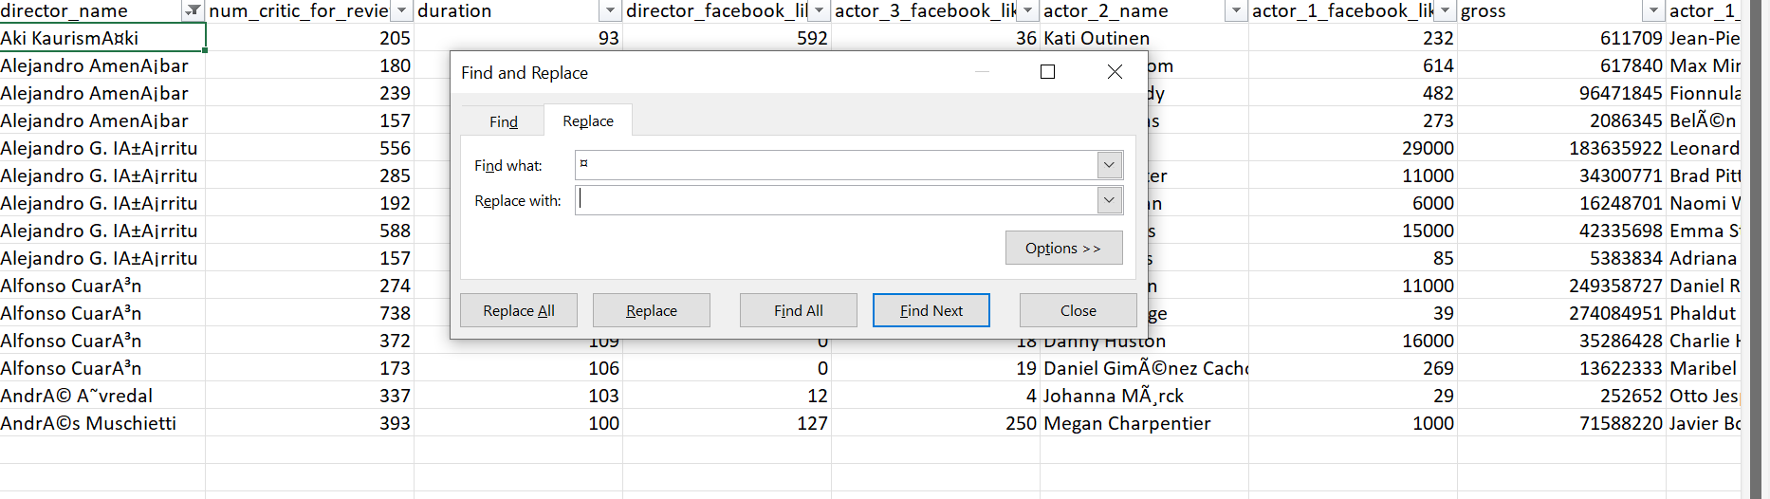
Sorting the data to find if there are any errors. Below is an example of an error in the data. I have to replace with the correct character to clear the error. So I am able to work with the data more effectively.

Slide 4
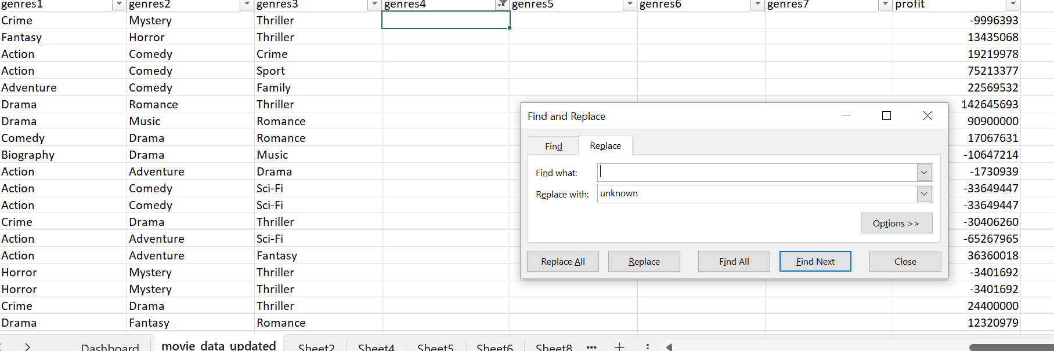
Filling gaps in data with unknown and if there are any missing numerical data you fill in the gaps with the average of the available data .

Slide 5
Insight 1:Finding the correlation between the budget of a movie with the Facebook likes of an actor. The top five high budgets. The popularity of a leading actor to some extent can affect the budget of a movie.
Actor name | Sum of budget | Sum of actor_1_facebook_likes
Johnny Depp | 3136600000 | 1560000
Robin Williams | 1346400000 | 1225000
Robert De Niro | 1535500000 | 924000
J.K. Simmons | 1907300000 | 744000
Jason Statham | 1001474000 | 650000

Slide 6
2.The effect of language on the profit of a movie. The more universal /the language is understood by a large audience the more the movie is able to give high profit. This makes language an important factor to consider while making a movie.
Language | Sum of Sum of profit
English | 11863138382
Maya | 10859889
Spanish | 6257896
Persian | 663780
Romanian | 595783

Slide 7
3.The genres and the profits earned .To find out how the genre of a movie can determine the earnings because of the preference of the audience.
Genre | Sum of profit
Adventure | 6473602117
Action | 5877535732
Horror | 3370369843
Comedy | 3212342514
Biography | 2263663972
Animation | 1514330085
Drama | 1310215035
Fantasy | 899873199
Family | 402981433
Mystery | 387846494
Documentary | 334113619
Musical | 177789000
Western | 39400000
Sci-Fi | 14456530
Romance | 12253315
Thriller | -297532
Crime | -2346968257

Slide 8
4.The effect of the critic reviews on the directors how it correlates to the the sum profit. The directors with the high number critic reviews seems to earn more profits. This would translate to the director being popular among the critic reviewers the better the performance of the movie directed.
Director Name | Sum of Sum of num_critic_for_reviews | Sum of Sum of profit
Steven Spielberg | 6526 | 2486332231
George Lucas | 1345 | 1386641480
James Cameron | 1878 | 1199625910
Joss Whedon | 2317 | 1000886628
Chris Columbus | 1567 | 941707624

Slide 9
5.The top five movies with the maximum duration against the IMDB score based the content rating. To find out whether the duration of a movie would help with the IMDB score based the content rating.
Content Rating | Average of imdb_score | Max of duration
R | 6.6 | 330
PG-13 | 6.3 | 280
PG | 6.3 | 271
Approved | 7.5 | 251
G | 6.5 | 226
Unrated | 6.9 | 202
Not Rated | 7.0 | 176
M | 7.5 | 142
NC-17 | 6.4 | 131
GP | 6.7 | 120
X | 6.5 | 109
Passed | 7.1 | 107

Slide 10
6.The sum of Facebook likes and the gross earning of a director. To find out whether the popularity of a director on the social media like Facebook can bring in high gross earnings in a movie.
Directors name | Sum of Sum of gross | Sum of Sum of director_facebook_likes
Steven Spielberg | 4114233101 | 350000
Clint Eastwood | 1378321100 | 304000
Martin Scorsese | 914609800 | 272000
David Fincher | 863904524 | 210000
Woody Allen | 308345443 | 209000

Slide 11
7.The budget compared throughout the last 10 years. The budget has decreased due to innovation of technology for, example the green screen which allows the actors seem in a different location while they are in a room, Previously they had to move to movie locations physically and other factors.
Title year | Sum of Sum of budget
2006 | 19749542000
2005 | 14156164211
2004 | 9128657498
2013 | 8305416167
2008 | 8196632000
2010 | 8187615000
2012 | 7718431375
2009 | 7587715000
2014 | 7581670000
2011 | 7517910000

Slide 12
8.The earnings of a movie depending on the country. The country can also be used to determine the success of a movie.
Country | Sum of Sum of profit
USA | 52792710499
UK | 1574370487
New Zealand | 245159794
Canada | 218593263
Australia | 206668349
South Africa | 103740241
Taiwan | 98681364
Mexico | 50609008
Argentina | 16792809
Peru | 12362581

Slide 13
9.The year a movie is titled and the sum profit of the movie. The pattern of the profits are unpredictable throughout the years .This means there are several factors that affect the profitability of a movie.
movie title year | Sum of Sum of profit
2012 | 3180732244
2014 | 2713508323
2002 | 2255673159
2013 | 2160214269
2009 | 2081781189
2015 | 2001164099
2003 | 1896841951
2007 | 1688356517
1994 | 1620334433
2001 | 1456639220

Slide 14
`10. Aspect ratio-this term refers to the proportional relationship between the width and height of an image or video. The below pivot table and chart helps to understand that there is a relationship between the IMDB score an the aspect ratio. The higher the aspect ratio the higher the IMDB score.
Movie genre | Sum of Sum of imdb_score | Sum of Sum of aspect_ratio
Action | 6031.9 | 2127.48
Comedy | 6101.6 | 1983.59
Drama | 4569.6 | 1414.96
Adventure | 2417.1 | 764.74
Crime | 1769.8 | 546.19
Biography | 1467.6 | 439.3
Horror | 959.2 | 344.84
Animation | 303.3 | 85.78
Fantasy | 232.4 | 76.19
Documentary | 176.7 | 63.08

Slide 15
THE END
THANK YOU

